Slide 1
Introduction to Visual Studio.Net 2015
September 9, 2016

Slide 2
Agenda
Getting Started
Projects and Solutions
Files and Folders
Quick look at Visual Studio
Finding Code
Seek Visual Studio Help

Slide 3
Projects and Solutions

Slide 4
Projects and Solutions
Each independently buildable thing in Visual Studio is a “Project”
May build to an Exe or a Dll
Contains code in a single language (C#, VB, C++ etc..)
Several projects may be combined in a “Solution”
The solution is what you open in Visual Studio
You can build the whole solution at once
Options and Settings apply at different levels
To your copy of Visual Studio e.g. Font choices, Tool pane layouts
To the solution e.g. which project to launch when you start a debug session
To the project e.g. Compiler options

Slide 5
Application Types
Visual Studio can build a wide variety of applications
Native or managed
Client
Windows Desktop e.g. WPF, Windows Forms, MFC etc..
Windows Phone
Windows Store
Web
ASP.Net Web Forms
ASP.Net MVC
Sharepoint Webparts
Many more..
Console Application
Windows Service
Web Service

Slide 6
Settings
Visual Studio settings apply to all solutions you open
There are number of “preset” settings
C++, C#, VB etc…
You can Export and Import settings
Share with your team
Switch to “presentation mode” and back
Demo

Slide 7
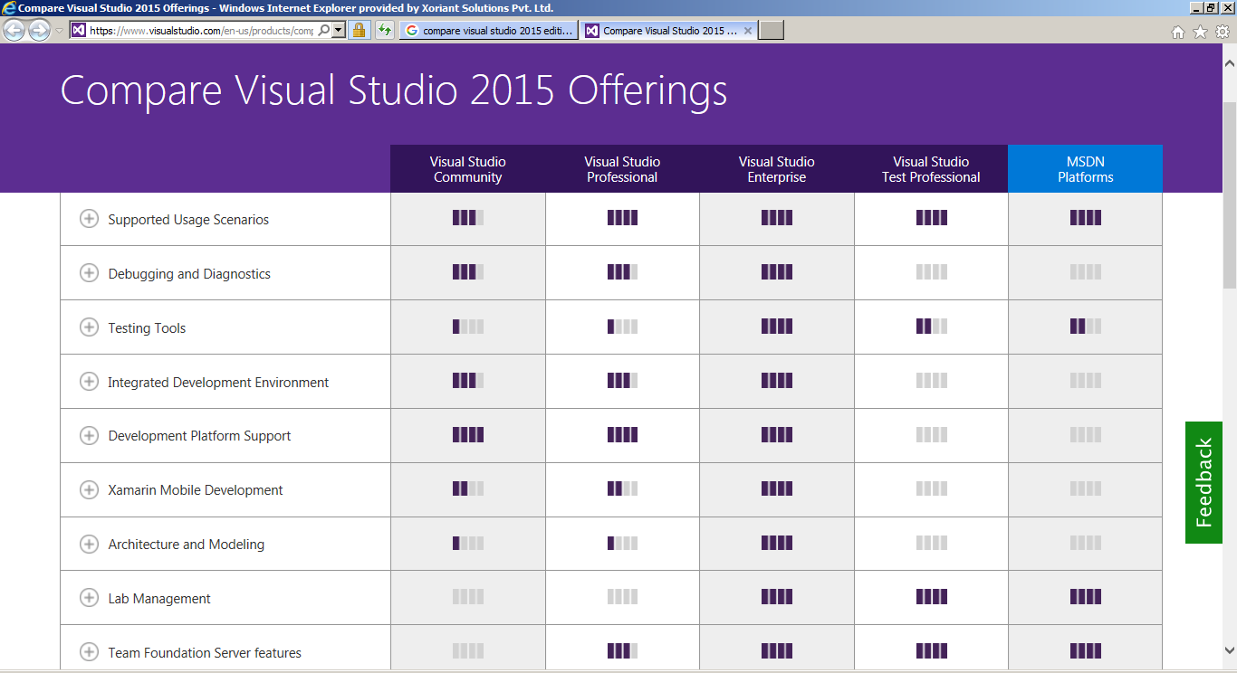
Visual Studio Versions and SKUs
https://www.visualstudio.com/en-us/products/compare-visual-studio-2015-products-vs.aspx

Slide 8
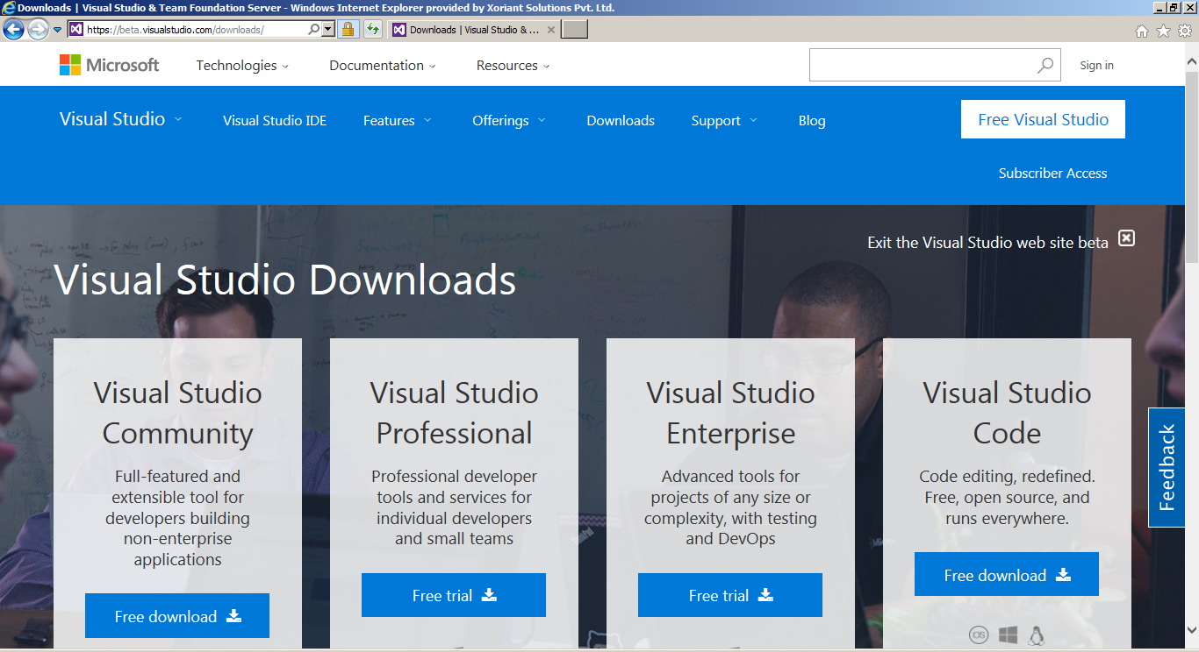
Download Visual Studio.Net
https://beta.visualstudio.com/downloads/

Slide 9
Demo: Installing Visual Studio.Net

Slide 10
Solutions
A Solution is (generally) what you open
Holds Projects
Most common way to create a solution
A containing solution is created when you create a project
You can create an empty one
Handy for controlling names
Demo Creating a solution

Slide 11
Projects
Can add as may you like to a Solution
Executable, class library
May need references between Projects
Being in the same solution doesn’t tell the build system anything
Typically add other references
.Net assemblies installed on your machine
COM components
Your own Net assemblies
WinRT components
Demo Adding a Project

Slide 12
Folders and Files

Slide 13
Using Namespaces
Referring to code in another assembly, use the full name of class
System.Windows.Window
GreetingLogic.Greeting
As a convenience, can “use” or “import” the namespace
Using System.Windows;
…..Window….
Using GreetingLogic;
……..Greeting……
Adding a reference doesn’t automatically use the references
Using the namespace doesn’t automatically add the reference
Demo Namespaces

Slide 14
Folders and SubFolders
Folder for Solution
Holds .sln, .suo
One folder under it for each project
Holds .csproj, all code files
Folder under project called bin
Short for Binaries
Typically has Debug and Release folders
These hold exe or dlls
Other folders under projects
Obj: used by Build system, can ignore
Properties: Visual Studio keeps project properties and code you don’t normally edit
Startup project has all the build outputs
Copies from other projects
Demo Folders

Slide 15
Architecture
Design your solution before opening Visual Studio
What projects will you add?
What will you name them?
Is it OK to have the solution same name as first project?
If not create an empty one and add the projects or rename after you create
Which projects will you refer to which
Avoid circular references
Think about where to put shared logic
May need to create an extra project to hold utilities
Get the structure in place and then add the code
Experience developers know where everything is placed
Visual Studio will help you to find them
Visual Studio lets you change almost everything
Sticking to he usual defaults makes life simpler for the rest of your team

Slide 16
Finding your way around Visual Studio

Slide 17
Start Page
Links to useful articles, videos
New Project
Recent Solutions (can remove from list if you like)
Closes itself once you use it
Demo Start Page

Slide 18
Toolbars
There are over Thirty Visual Studio toolbars
They show up in context
You can control them if you like- add one that you use a lot
You can also control what commands are on each toolbar
Generally wait until you know your way around – there is a good chance the command is on the toolbar already
The menus remind you of both toolbar symbols and keyboard shortcuts
Demo Toolbars

Slide 19
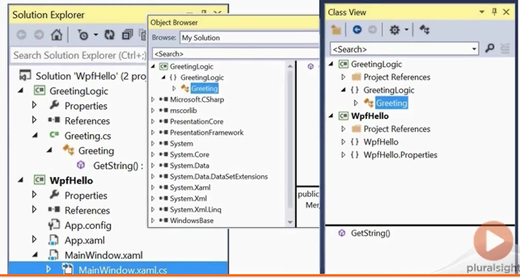
View Menu
Perfect for “How do I get that back?”
Not every view applies to every kind of application
Demo View Menu

Slide 20
Beyond Docking
Panes can dock to top, bottom, left, right and center
Hold ctrl when releasing to prevent docking
Can pull out onto second monitor (or third)
Tabs have significant context menu
Central area can be split horizontally or vertically
Zoom in and out with dropdown or scroll wheel
Demo Docking

Slide 21
Finding Code

Slide 22
Class View
Look at your code as classes not as files
Some of this is in the Solution Explorer too
See Inheritance hierarchies
See methods, properties & so on
Easy to navigate to the code
View is Customizable
Sort Order
Filtering
Can even do some code changes
Demo: Class View

Slide 23
Seeing Code your code calls
Code Definition Window
Go to Definition
Peek Definition
Demo: Seeking code calls

Slide 24
Back and Forward
Navigate
Tab Dropdown
Windows Menu
Bookmarks
Demo: Back and Forward

Slide 25
Finding
Find Dialog
Incremental & Instant
F3 to repeat
Ctrl F3
Find in files
Find Symbol
Navigate To
Demo: Finding

Slide 26
Finding Code (Advanced)

Slide 27
Finding
Find Dialog
Incremental & Instant
F3 to repeat
Ctrl F3
Find in files
Find Symbol/ Navigate To
Searching in Tool window
Demo: Advanced Finding

Slide 28
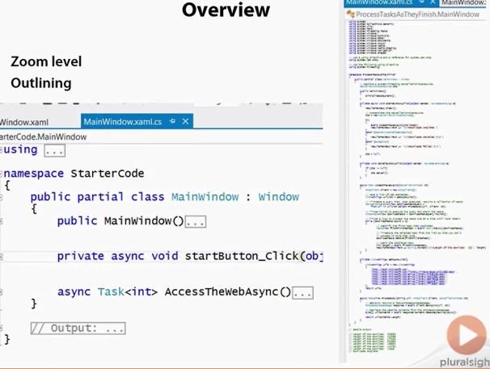
Overview
Zoom Level
Outlining
Demo

Slide 29
Enhanced Scrollbar
Shows mini map of the entire file with colored squares for
Current Line
Currently showing on the screen
Unsaved and Saved changes
Find results
Breakpoints
Bookmarks
Error or warning “wiggles”
Demo: Scrollbar

Slide 30
Output and Errors
Error view is a grid and si sorted and arranged
Warnings and errors can be treated separately
Output view is more “stream of consciousness”
Either one can take you strait to the error
Demo: Error and Output view

Slide 31
Seek Visual Studio Help

Slide 32
Visual Studio will fix your Errors
Visual Studio know more than it shows you
Can figure out “What you meant”
Don’t fix mistake by hand until you have seen if Visual Studio might be willing to fix it for you
Demo: Fixing Errors

Slide 33
Snippets
Common pieces of the language you use regularly
And specially those you don’t use often
Very considerate
Cursor ends up just where you wants it
Tab is the key to good snippet use
Demo: Snippets

Slide 34
Work with Intellisense
Not getting suggestions means something wrong
Don’t just keep typing
Fix errors on the fly so you get intellisense back
Add the reference before trying to use it
Declare functions and variables early
Before you try to use them
Or the minute you have tried – generate stub, field or property
Stay in flow and type as little as possible
Demo: Intellisense

Slide 35
Help
Visual Studio has an extensive Help system
Most developers ignore it
Online
Context sensitive MSDN search
Offline
Works anywhere
Takes sometime to setup
Samples Gallery
Search options and other tools
Quick Launch
Demo Help

Slide 36
Debugging

Slide 37
Demo Snippets
Basic Debugging
Additional Debugging Features
IntelliTrace and Code Map
Working with Designers
Useful Extensions

Slide 38
Build Configurations
A gathering of settings related to building your project is called Build Configuration
How much optimizing?
How much error checking?
When you create a new project, you get a Debug and a Release build configuration
You could add others
You could change these
Changing Build Configurations dramatically should wait until you are familiar with debugging

Slide 39
Where are the files?
Under the project folder is a bin folder
Debug
Release
(C++ is little different)
You can run these exe’s directly
You can copy them elsewhere to hand-deploy your app

Slide 40
Breaking Execution
Pause the application
You can look at the variable values
Understand what is happening and why
Important concepts
Breakpoint
Step over
Step into
Step out
Continue
Demo Breaking Execution

Slide 41
Additional Debugging Features

Slide 42
Data Tips, Visualizers and Watches
Hover over a variable to see its value
Any line of code (not just the one about to execute)
Expand members and drill through as necessary
Use powerful Visualizers
Pin a tip
Understand the difference between Autos and Locals
Add watches if your locals and auto window is crowded
Demo Data Tips, Visualizers and Watches

Slide 43
More Complicated Values
Values of an Expression
Quick Watch
Command Window
Immediate Window
Demo More Complicated Values

Slide 44
Beyond “Step Over”
Step over, Step into, Step out, are the basics
Run to Cursor spares you from creating too any beakpoints
Set Next Statement
You need to be sure of yourself
Change a variable’s value while running
Change your code while running
“Edit and Continue”
Demo

Slide 45
IntelliTrace and Code Map

Slide 46
IntelliTrace Basics
Available in Visual Studio Ultimate only
Saves a trace file of execution path and values of member variables
Also locals/autos if you have that window open
By default has very little performance impact
Can gather info more often once you know you need it
Edit and Continue will be suppressed by gathering more often

Slide 47
IntelliTrace for Time Travel
Run your app under the debugger
Pause at the breakpoint if you like
Run right past the problem
Exception
Bad Result
Anything unexpected
Break (at a breakpoint or Break All)
Look at values
Move forward and backward along the execution path
Understand exactly why the bug happened

Slide 48
Demo Intellitrace

Slide 49
Code Map
Available in Visual Studio Ultimate only
Builds the diagram as you debug
Functions called
You can annotate the diagram and add more details
Comments
What objects contains the functions
What member variables the functions use
Possible trouble spots
Share the diagram with others
Image
Dgml format
Demo: Code Map

Slide 50
Working with Designers

Slide 51
Building User Interfaces with Visual Studio
Windows Applications
Windows Store Applications (Windows 8+ only)
WPF
Silverlight “Out of the browser”
Windows Forms
XNA, MFC, and more
Web Applications
Web Forms
MVC
Single Page Applications
Phone Applicaions
Plugins, extensions and hosted controls
Office, Visual Studio Ribbon Designers etc

Slide 52
Fundamentals
Toolbox
Drag on control, drag it around
Double-click if you don’t care where it lands
Double click to edit handler for most common event
Eg for a button:click event
Get the control’s name right before adding handler to save effort later
Editing the underlying code

Slide 53
Properties and Handlers
If you would rather type a numblue er, use Properties
See what happens when you double click a property value
Every Control has a “most important event”
Double-click the control to add /edit handler
Other events are on Properties
Also look for Smart Tags

Slide 54
Layout
Visual cues about alignment and distance
Multi select
Toolbar buttons for easier snapping in Windows Forms
Same effect is part of your design in XAML
Tab Order

Slide 55
Demo Disigner Features

Slide 56

Thank You!
Prashant Kulkarni
Technical Lead
Mobile: +91 9890913122
Desk: +91 20 66046341
Prashant.kulkarni@xoriant.com
www.xoriant.com
India
Mumbai
4th Floor, Nomura
Powai , Mumbai 400 076
Pune
5th Floor, Amar Paradigm
Baner, Pune 411 045
Kolkata
2B, 12th Floor, Tower ‘C’
Rajarhat, Kolkata 700 156
US – Corporate Headquarters
1248 Reamwood Avenue,
Sunnyvale, CA 94089
Phone: (408) 743 4400
343 Thornall St 720
Edison, NJ 08837
Phone: (732) 395 6900
UK
20 Broadwick Street
Soho, London
W1F 8HT, UK
89 Worship Street
Shoreditch,
London EC2A 2BF, UK
Phone: (44) 2079 938 955
Bangalore
4th Floor, Kabra Excelsior,
80 Feet Main Road, Koramangala 1st Block,
Bengaluru (Bangalore) 560034
Gurgaon
A/373rd Floor, Sigma Center
Gurgaon, Haryana 122 011s

